Slide 1
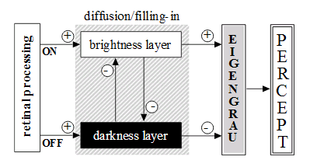
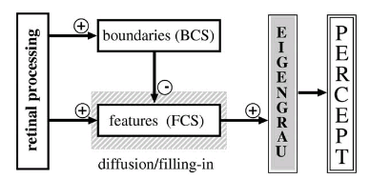
Context of BEATS filling-in
How does the visual system assign perceptual attributes?
Contrast activity used to fill boundary regions (Walls 1954)
Framework for filling-in involving two contrast sensitive channels: Retinal ON (brighter than grey) and OFF (darker than grey) channels (Gerritts & Vendrick 1970)
“Standard filling-in” formalized with two subsystems: both using ON & OFF channels, edge detecting boundary system which controls the filling-in feature system (Grossberg & Cohen 1984)

Slide 2
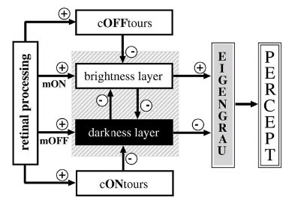
Where BEATS fits in
Standard filling-in fails in accurately representing real world images, in that it has multiple artefacts.
BEATS is a hybrid of previous models in that, there are dark contours and bright contours being fed into each respective darkness filling-in and brightness filling-in layers, with a mutual inhibition between these layers.
Described as “multiplex code” in that luminance and contrast information are simultaneously encoded.

Slide 3
Significance in context of current work
Single-scale brightness of real world images can be recovered from single-scale high-pass information → Single-scale high-pass noise has been found to disrupt lightness computations.
BEATS predicts lightness effect observed in SBC.

Slide 4
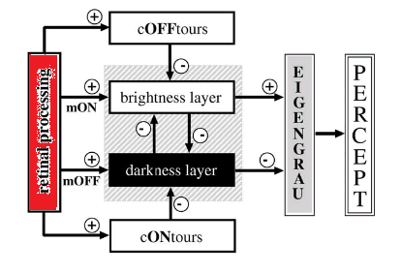
Dynamic Normalisation Network – Overview
The normalization scaling scheme here relies on solving the 2D heat diffusion equation with two operator components (T & K) steering the equation between different behaviour states.

Slide 5

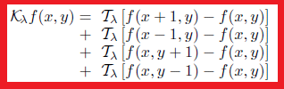
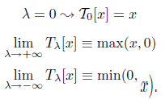
Dynamic Normalisation Network – Diffusion equation
The diffusion equation is steered by λ through T and K.
T operator states either linear, half-wave rectify or inverse half-wave rectify process.
K applies T operator to nearest neighbourhood. Sums max/min contrast in local surround.

Slide 6




Normalization Network – Diffusion equation continued
Diffusion equation in minimum and maximum states (a & b) describe diffusion layer evolution.
Solving these equations we can put them into the linear and dynamic ON-type normalization schemes

Slide 7


Normalization Network – Diffusion equation continued
These normalization processes can be used to compute the inverse normalisation process, namely OFF-type contrast.
The evolution of the dynamic solution resembles darkness filling-in.

Slide 8
Brightness/Darkness diffusion layers
Output activities are half-wave rectified

Slide 9
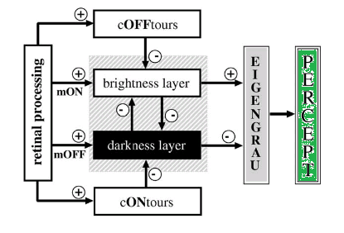

Perceptual Activity
Perceived activity of filled-in surface representations
For visualizing the output

